Slide 1
South St. Petersburg CRA Eviction Prevention & Probate Assistance Program South St. Petersburg CRA CAC Public Meeting September 5th , 2023

Slide 2
City Administration Requested Actions South St. Petersburg CRA Housing & Neighborhood Revitalization Program
Agency Recommend & City Council Approve:
Agreement with Community Law Program, Inc. to provide pro-bono legal services to SSPCRA residents who are facing eviction and provide probate services to clear title to homes that may be in the name of deceased persons.
Allocate $300,000 through South St. Petersburg Community Redevelopment Area Tax Increment Financing funds: Housing and Neighborhood Revitalization Pillar.
Notes:
The requested action is that the Redevelopment Agency recommends that the City Council approve the re-allocation of $2.15 million in the Housing & Neighborhood Revitalization Budget to the Affordable Housing Incentive Program. The funds will be reallocated from two developments-Pelican Place, a planned 44-unit development on City Owned Land at 18th Ave. & 21st. St. and The Grove, a planned 12 Unit development on 18th Ave. & 18th St. Both developments have been awarded to Habitat for Humanity and are in the final stages of negotiations with City Administration. The funds will then be allocated to the “Affordable Housing Incentive Program” to support several affordable housing initiatives.

Slide 3
Overview Community Law Program, Inc.
Community Law Program (CLP) is a 501(c)(3) non-profit corporation that provides free civil legal services to financially eligible residents and qualified non-profit organizations in Pinellas County.

Slide 4
Overview Eviction Prevention
Eviction Prevention
Designed to assist individuals facing eviction
Not limited to after an eviction complaint has been filed
When notice has been provided indicating that tenant may be displaced
When a tenant fears an eviction may be eminent due to the inability to pay.

Slide 5
Overview Eviction Prevention
Not restricted by household income
Will provide legal advice to tenants
Negotiate voluntary payment schedule and relocation agreements
Draft & file pleadings in court; represent tenants throughout formal eviction proceedings
Help mitigate harsh consequences of an eviction record.

Slide 6
Overview Probate Assistance
Probate Assistance
Property appraiser data shows 348 estate property parcels in SSPCRA
Pro-bono legal services to clear title of homes that may be in the name of deceased persons
Draft & file pleadings in court
Approved applicant's household income <120% AMI

Slide 7
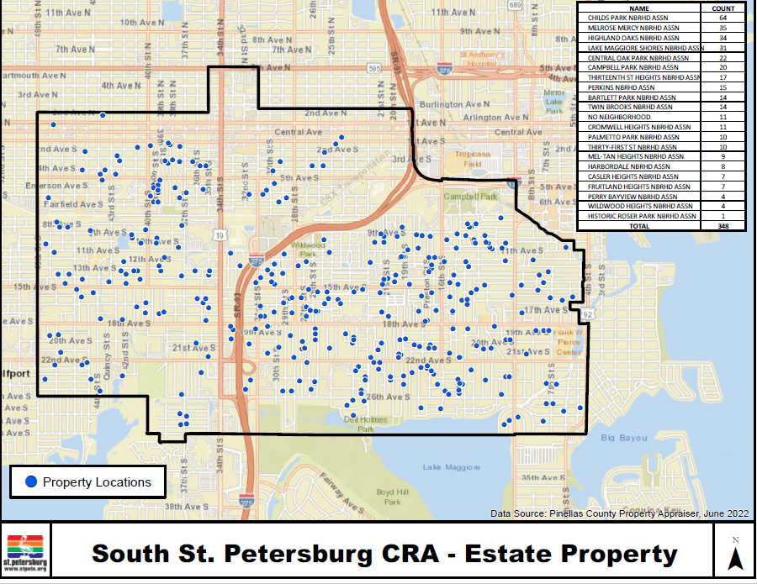

Slide 8
Agreement Overview Eviction Probate & Probate Assistance
Eviction Prevention
$95,000- Full time attorney or equivalent to provide Eviction Prevention services to tenants residing within the boundaries of the SSSPCRA
$5,000-Court fees and costs for represented individuals and for no other purpose
Payment will not include payment for back rent, payment into court’s registry, or attorney fees.

Slide 9
Agreement Overview Eviction Probate & Probate Assistance
Probate Assistance
$200,000-funds to hire attorney’s and assistants or fund existing positions to provide the probate assistance to individuals.
Pay court fees and costs, reasonable clerical costs and other necessary costs to clear titles
Administrative, supervisory, and management reporting services not to exceed 5% of total grant amount

Slide 10
City Administration Requested Actions South St. Petersburg CRA Housing & Neighborhood Revitalization Program
Agency Recommend & City Council Approve:
Agreement with Community Law Program, Inc. to provide pro-bono legal services to SSPCRA residents who are facing eviction and provide probate services to clear title to homes that may be in the name of deceased persons.
Allocate $300,000 through South St. Petersburg Community Redevelopment Area Tax Increment Financing funds: Housing and Neighborhood Revitalization Pillar.
Notes:
The requested action is that the Redevelopment Agency recommends that the City Council approve the re-allocation of $2.15 million in the Housing & Neighborhood Revitalization Budget to the Affordable Housing Incentive Program. The funds will be reallocated from two developments-Pelican Place, a planned 44-unit development on City Owned Land at 18th Ave. & 21st. St. and The Grove, a planned 12 Unit development on 18th Ave. & 18th St. Both developments have been awarded to Habitat for Humanity and are in the final stages of negotiations with City Administration. The funds will then be allocated to the “Affordable Housing Incentive Program” to support several affordable housing initiatives.

Slide 11
Eviction Prevention & Probate Assistance Program South St. Petersburg CRA Housing & Neighborhood Revitalization Program
Questions?
Notes:
The requested action is that the Redevelopment Agency recommends that the City Council approve the re-allocation of $2.15 million in the Housing & Neighborhood Revitalization Budget to the Affordable Housing Incentive Program. The funds will be reallocated from two developments-Pelican Place, a planned 44-unit development on City Owned Land at 18th Ave. & 21st. St. and The Grove, a planned 12 Unit development on 18th Ave. & 18th St. Both developments have been awarded to Habitat for Humanity and are in the final stages of negotiations with City Administration. The funds will then be allocated to the “Affordable Housing Incentive Program” to support several affordable housing initiatives.

